Slide 1
A Model for Intelligent Greenhouse
~ Soumodeep Dutta M.Sc. Computer Science Under The Guidance of Prof. Vivek Kumar Singh

Slide 2
Introduction
What is IOT ?
It is anything and everything that uses some embedded technology to communicate with each other.
Coined By Kevin Austin in the year 1999.
Why IOT ?
The analyst firm Gartner says that by 2020 there will be over 26 billion connected devices.
According to McKinsey the total economic impact of IoT in industrial worksites and factories in 2025 will be $1.3T-$4.6T.

Slide 3
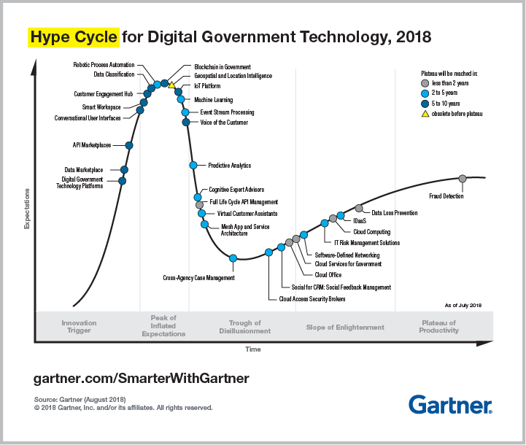
Introduction (contd.)
According to the Gartner 2018 Hype Cycle of Emerging Technologies, IOT is current at the Peak of Inflated Expectation.
In 2013, the Global Standards Initiative on Internet of Things (IoT-GSI) defined the IoT as “the infrastructure of the information society.”

Slide 4
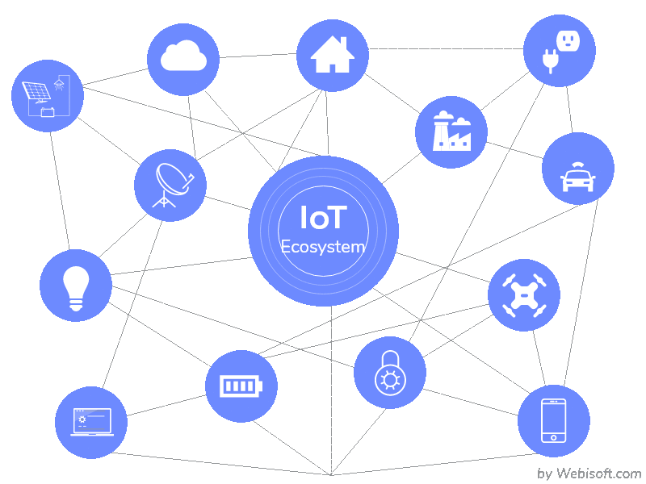
IOT Ecosystem
Smart devices and sensors
Gateway
Processing
User Interface

Slide 5

IOT to Modernise Agriculture
Data, tons of data, collected by smart agriculture sensors.
Better control over the internal processes and, as a result, lower production risks.
Cost management and waste reduction thanks to the increased control over the production.
Increased business efficiency through process automation.
Enhanced product quality and volumes.

Slide 6
Related Work
Joaquín Gutiérrez in his paper “Automated Irrigation System Using a Wireless Sensor Network and GPRS Module,” have developed an automated irrigation system to optimize water use for agricultural crops using WSN.
90% saving of water
the system used photovoltaic cells and was implemented in geographically isolated areas

Slide 7
Related Work(contd.)
Shaik Jhani Bhasha in her paper on “Agricultural field monitoring and automation using PIC16F877A microcontroller and GSM” has implemented the system monitors the water feeding activity in fields.
PIC16F877A microcontroller
GSM module
water level sensors
water motor can be turned on or off by farmers remotely

Slide 8
Related Work(contd.)
R. Nageswara Rao in his paper “IoT based smart crop-field monitoring and automation irrigation system” has developed a system whose goal is using a low quantity of water for crop development.
system has implemented Precision Agriculture (PA) with cloud computing

Slide 9
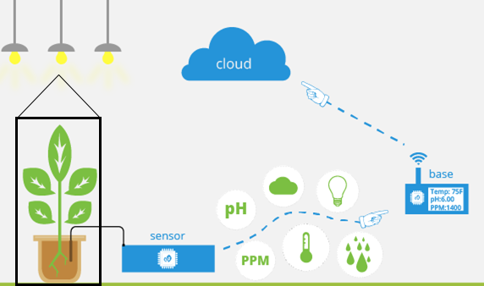
Proposed System
A miniature model of a working greenhouse environment monitored and controlled in real time.
Environment Parameters considered :
Temperature
Humidity
soil moisture
ambient light present
Controlled using various actuators.

Slide 10
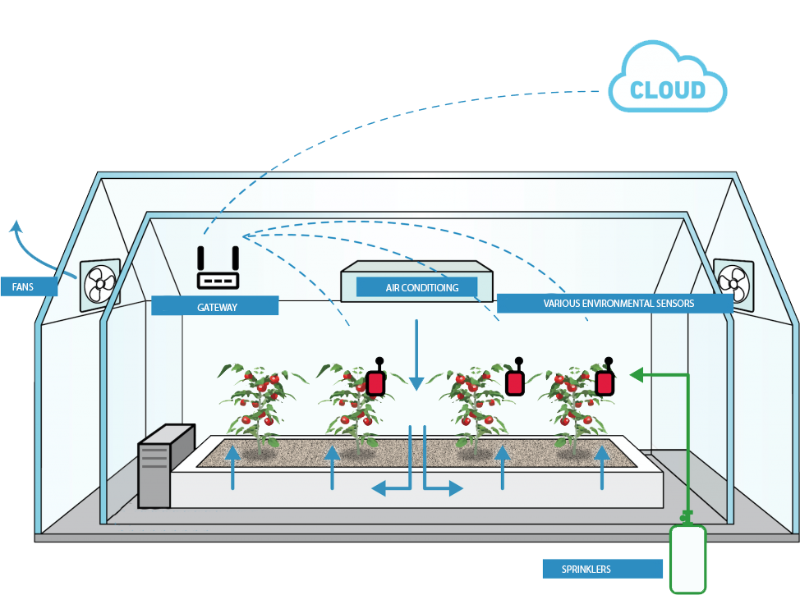

Slide 11
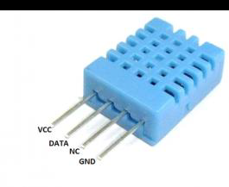
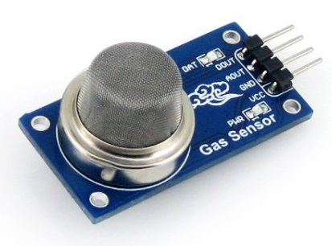
Sensors
DHT11 -
humidity and temperature sensor
MQ2 Sensor: Gas Sensor

Slide 12
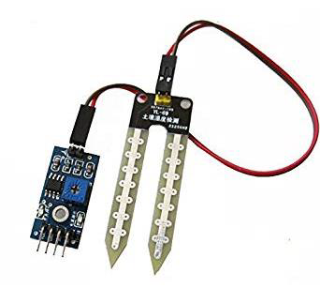
Sensors(contd.)
Soil-Moisture with LM-393
LDR LM-393 – Ambient Light Sensor

Slide 13
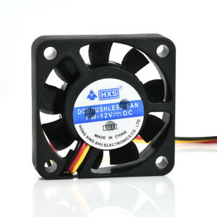
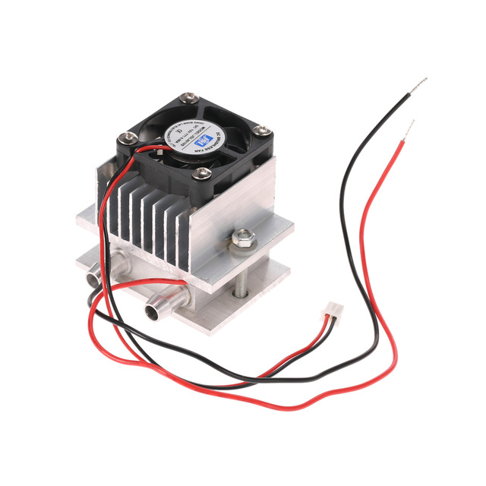
Actuators
Peltier Module
Water Sprinkler
Exhaust Fan
Artificial Light

Slide 14

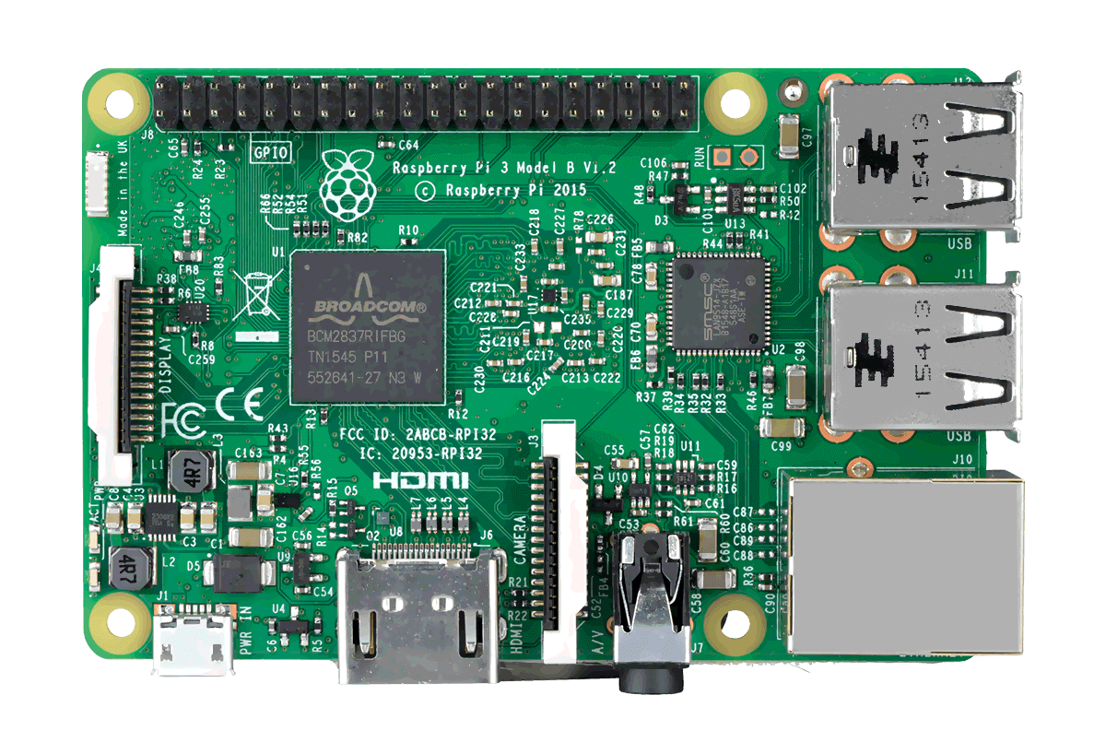
Processing
Arduino Uno with ATmega328P µC
ESP-8266– Wi-Fi Module

Slide 15
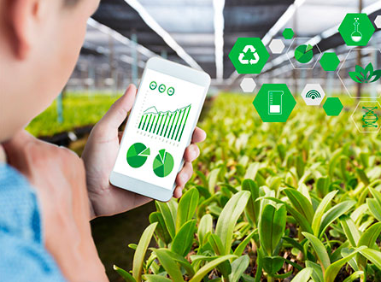
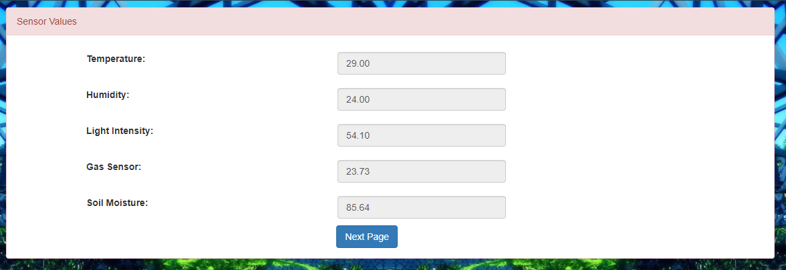
User-Interface
It is the topmost layer of an IOT system visible and used by the user. It can be in the form of a Web-Based Platform which will display the real-time data to the user also allow to regulate the functionalities of the IOT Ecosystem.

Slide 16
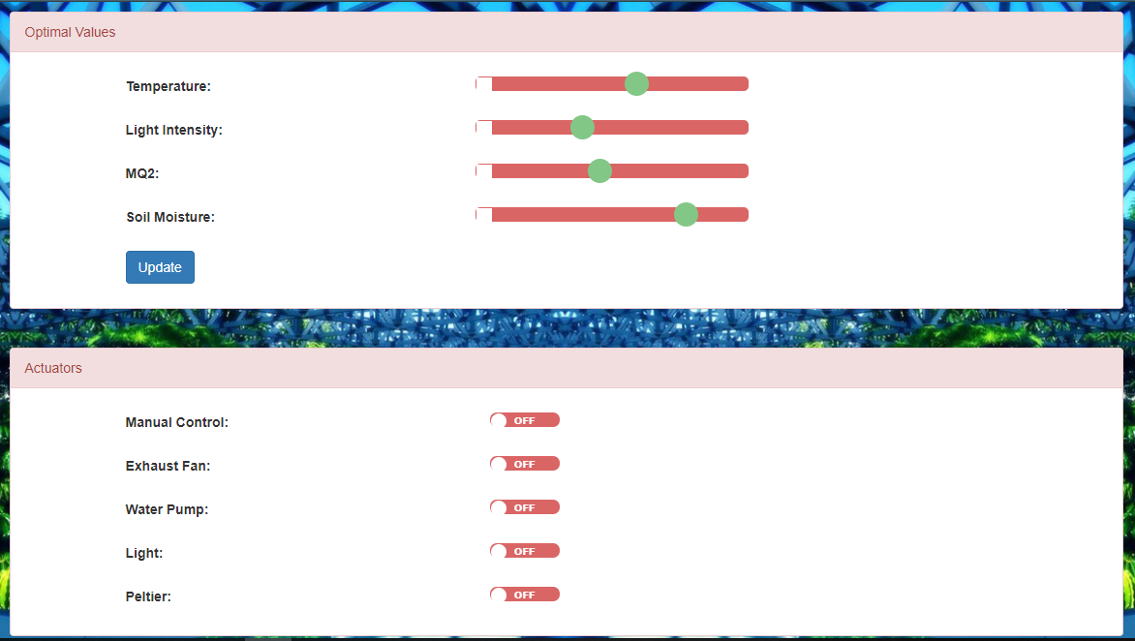
User-Interface(contd.)

Slide 17
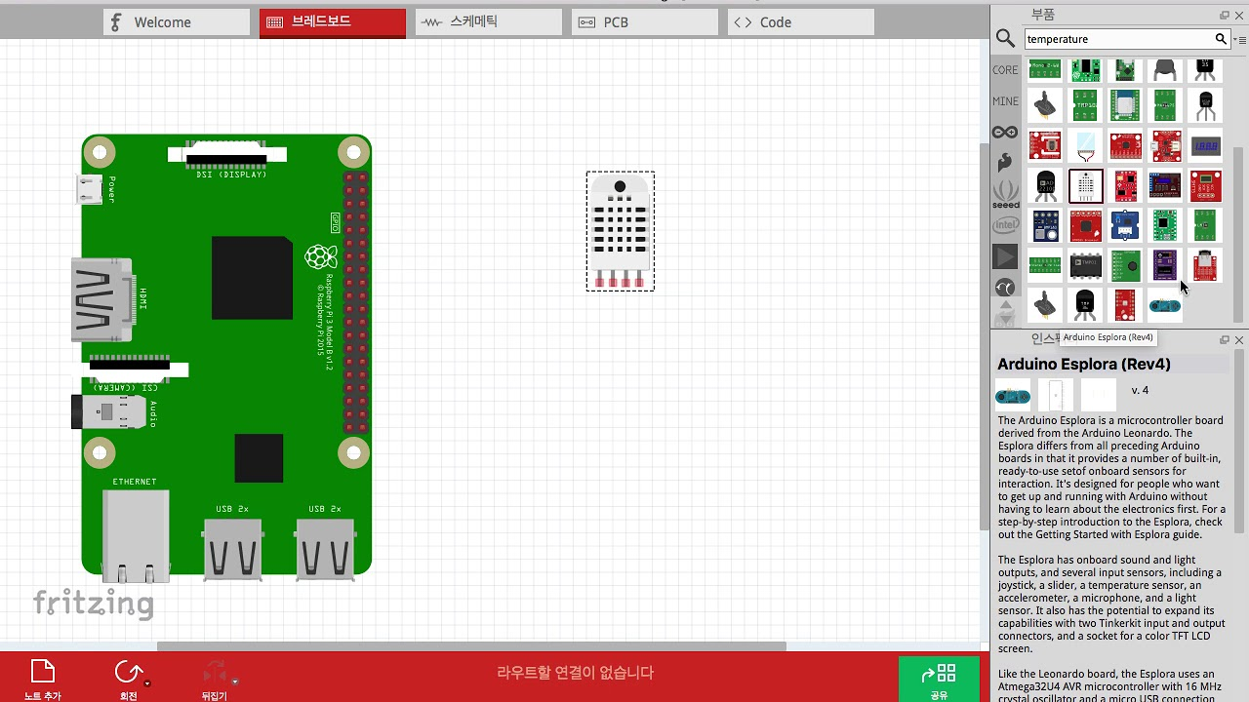
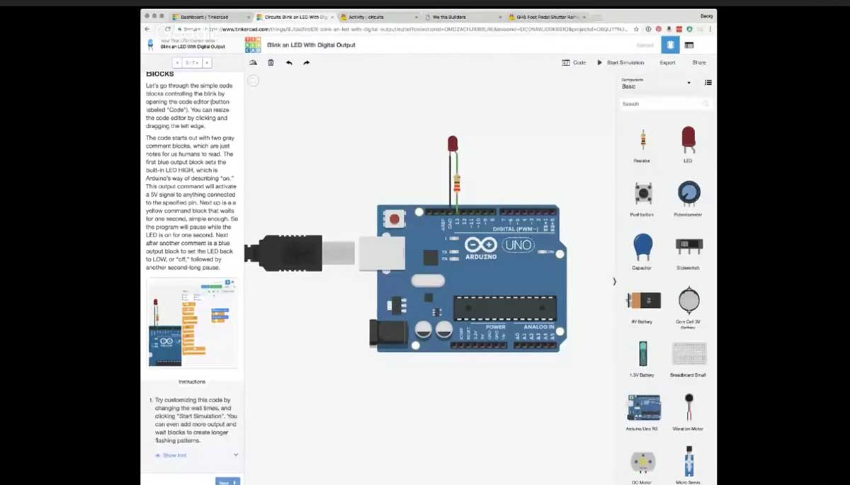

SYSTEM ARCHITECTURE
Exhaust Fan
Water Pump
RELAY
Artificial Light
Peltier Module+ Fan

Slide 18

DHT11
ARDUINO UNO MICRO-CONTROLLER
MQ2
REMOTE DESKTOP
ANALOG / DIGITAL PINS
LDR
SOIL MOISTURE
REMOTE MOBILE
USB PORT
RASPBERRY PI 3 MODEL B
GPIO PINS
RELAY MODULE
EXHAUST FAN
ARTIFICIAL LIGHT
PELTIER MODULE
WATER PUMP

Slide 19
Procedure
Start
Arduino Uno acquires sensor data continuously connected through its input pins with 1-second interval.
Analog to Digital conversion of the sensor data on the Arduino Board.
All the sensor data are accumulated and converted to CSV format
Transmission of the data to the Raspberry Pi through USB.
Raspberry Pi running a python script continuously listens for incoming data.
Automation in Raspberry Pi - If the sensor data is above the threshold
The Pi automatically Turns ON the control measure by sending a signal to the corresponding actuator.
Else If the data is within a threshold
The Pi automatically Turns OFF the corresponding actuator or Turns ON another related actuator.
Else If Automation Turned OFF
The user has full control over any of the actuators and can change its state using the web application
Continue checking for the threshold condition for each sensor, GOTO Step 5
Endif
End

Slide 20
DECISION MAKING
IF | THEN
Soil moisture level low | Turn on the water sprinkler
Soil moisture level ok | Turn off the water- sprinkler
Gas conc. high | Fire Alert
Temperature high | Turn on the Exhaust
Temperature low | Turn on the Peltier module to heat up mode
Ambient light low | Turn on Artificial light
Ambient light OK | Turn off Artificial light.

Slide 21
Conclusion
This paper provides a model for an intelligent greenhouse its architecture and functionality.
It depicts the benefit of using IoT in agricultural sector mainly in the greenhouse.
Using the cloud for data processing and analysis we can monitor and analyse the sensor data, and access historical data easily.
All of these are low cost, low power sensors which can enable a to maintain, monitor and control any number of greenhouses sitting in any corner of the globe as long as he has an active internet connectivity within them.

Slide 22
Future Scope
We have been using 6 parameters for this model.
We can include precision fertilization and pest removal module.
We can also improve the model by using IP cameras that can be used for monitoring purpose also using image processing we can detect any kind of diseases in plants, yield rate of a plant and much more.
A module to check the quality and type of soil and recommend the crop best suited for this soil can be integrated that will benefit farmer.
THANK YOU

Slide 23
References
D. Liu, X. Cao, C. Huang, and L. Ji, “Intelligent agriculture greenhouse environment monitoring system based on IOT technology,” Proc. - 2015 Int. Conf. Intell. Transp. Big Data Smart City, ICITBS 2015, pp. 487–490, 2016.
K. A. Patil and N. R. Kale, “A model for smart agriculture using IoT,” Proc. - Int. Conf. Glob. Trends Signal Process. Inf. Comput. Commun. ICGTSPICC 2016, pp. 543–545, 2017.
G. Sushanth and S. Sujatha, “IOT Based Smart Agriculture System,” Int. J. Recent Innov. Trends Comput. Commun., vol. 2, no. February, pp. 177–181, 2017.
J. Gutiérrez, J. F. Villa-Medina, A. Nieto-Garibay, and M. Á. Porta-Gándara, “Automated Irrigation System Using a Wireless Sensor Network and GPRS Module,” IEEE Trans. Instrum. Meas., 2013.
R. Nageswara Rao and B. Sridhar, “IoT based smart crop-field monitoring and automation irrigation system,” Proc. 2nd Int. Conf. Inven. Syst. Control. ICISC 2018, no. Icisc, pp. 478–483, 2018.
N. Suma, S. R. Samson, S. Saranya, G. Shanmugapriya, and R. Subhashri, “IOT Based Smart Agriculture Monitoring System,” Int. J. Recent Innov. Trends Comput. Commun., vol. 2, no. February, pp. 177–181, 2017.
C. Liu, W. Ren, B. Zhang, and C. Lv, “The application of soil temperature measurement by lm35 temperature sensors,” International Conference on Electronic and Mechanical Engineering and Information Technology,vol. 88, no. 1, pp. 1825–1828, 2011.
S. J. Bhasha and S. M. Hussain, “Agricultural field monitoring and automation using PIC16F877A microcontroller and GSM.,” vol. 3, no. 6, pp. 2155–2157, 2014.
I. Mohanraj, K. Ashokumar, and J. Naren, “Field Monitoring and Automation Using IOT in Agriculture Domain,” Procedia Comput. Sci., vol. 93, no. December 2016, pp. 931–939, 2016.
H. Chang, N. Zhou, X. Zhao, Q. Cao, M. Tan, and Y. Zhang, “A new agriculture monitoring system based on WSNs,” Int. Conf. Signal Process. Proceedings, ICSP, vol. 2015–Janua, no. October, pp. 1755–1760, 2014.
A. Sangeetha, P. Sarah, and G. Poovarasi, “IOT BASED HYBRID SYSTEM FOR PRECISION AGRICULTURE MONITORING USING WSN INTO MODERN INFORMATION AND COMMUNICATION TECHNOLOGY ( ICT ),” no. 2, pp. 3116–3124, 2018.
D. Stipanicev and J. Marasovic, “Networked embedded greenhouse monitoring and control,” Control Appl. 2003. CCA …, pp. 1350–1355, 2003.
Yunseop (James) Kim, R. G. Evans, and W. M. Iversen, “Remote Sensing and Control of an Irrigation System Using a Distributed Wireless Sensor Network,” vol. 57, no. 7, pp. 1379–1387, 2008.
J. Shen, J. Song, Q. Han, S. Wang, and Y. Yang, “A remote measurement and control system for greenhouse based on GSM-SMS,” 2007 8th Int. Conf. Electron. Meas. Instruments, ICEMI, pp. 282–285, 2007.

Slide 24
References(contd.)
Mahesh M. Galgalikar, “Real-Time Automization Of Agricultural Environment for Social Modernization of Indian Agricultural System ”, 978- 1-4244-5586-7/1 C 2010 IEEE.
Chetan Dwarkani M, Ganesh Ram R, Jagannathan S, R. Priyatharshini “Smart agriculture system using sensors for agricultural task automation,” in 2015 IEEE International Conference on Technological Innovations in ICT for Agriculture and Rural Development (TIAR 2015).
Jeetendra Shenoy, Yogesh Pingle “IOT in agriculture,” 978-9-3805-4421-2/16/, IEEE. 2016.
Abdullah Na, William Isaac, “Developing a human-centric agricultural model in the IOT environment,” in 2016 International Conference on Internet of Things and Applications (IOTA) Maharashtra Institute of Technology, Pune, India 22 Jan - 24 Jan, 2016, 978-1-5090-0044-9/16,2016 IEEE.
Kim Y,Evans R G,Iversen W M. Remote sensing and control of an irrigation system using a distributed wireless sensor network. IEEE Transactions on Instrumentation and Measurement . 2008
Han, W., Z. Yang, et al. 2012. CropScape: A Web service based application for exploring and disseminating US conterminous geospatial cropland data products for decision support. Computers and Electronics in Agriculture, 84: 111-123.
What are the major components of Internet of Things - RF Page.” [Online]. Available: https://www.rfpage.com/what-are-the-major-components-of-internet-of-things/. [Accessed: 12-Dec-2018].
“IoT Ecosystem Components: The Complete Connectivity Layer.” [Online]. Available: https://www.newgenapps.com/blog/iot-ecosystem-components-the-complete-connectivity-layer. [Accessed: 10-Dec-2018].
Ashton K., “That ‘Internet of Things’ Thing,” RFID J., p. 4986, 2009.
J. Gubbi, R. Buyya, and S. Marusic, “Internet of Things (IoT): A Vision, Architectural Elements, and Future Directions,” Atmos. Environ., no. 1, pp. 1–19, 2013.

